Slide 1

Senior Design: Robo-Cub
Team: Ivan Cortez, Ashour Shamoun, Sarthak Bhatia
Advisor: Farbod Khoshnoud

Slide 2
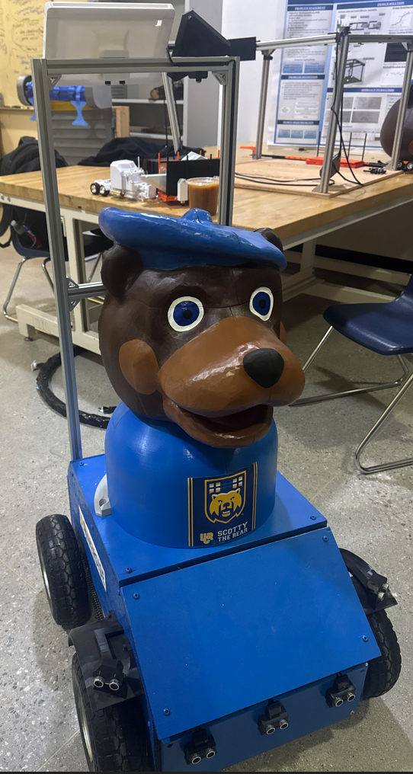
Purpose / Project Idea
UC Riverside welcomes so many new students and visitors each year, and finding your way around campus for the first time can be stressful or confusing.
Robo-Cub is designed to help by offering a simple and accessible way to explore campus and reach key locations without needing prior knowledge of where things are.
With smart sensors and navigation technology, it can safely move alongside people — even in busy walkways, uneven outdoor areas, or inside buildings.
The system focuses on being cost-efficient, dependable
The goal is to create a friendly, helpful tour experience that showcases the innovative spirit of UC Riverside.

Slide 3
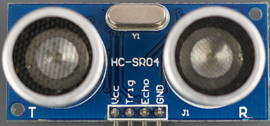
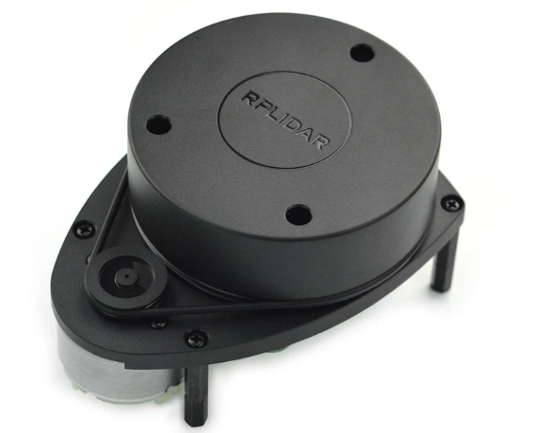
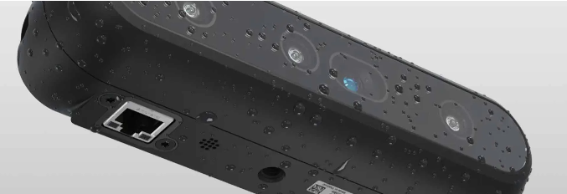
Sensor
LiDAR + Ultrasonic = strong navigation + safety
Camera = human interaction and recognition (bonus feature)
Ultrasonic Sensors
Help Robo-Cub notice nearby obstacles like people or benches so it can react quickly
Affordable and simple, making them great for safety in tight or crowded areas
https://www.youtube.com/watch?v=wCOPLVgNpcY
https://www.youtube.com/watch?v=A33Dxrkd-WQ
LiDAR
Builds a detailed map of the surroundings for smooth navigation through complex paths
Provides precise distance data so the robot can plan smart, safe routes
https://www.dfrobot.com/product-1125.html
https://www.youtube.com/watch?v=VhbFbxyOI1k
Vision Cameras
Allow Robo-Cub to recognize people and respond to gestures or movement
Improve interaction by helping the robot “see” what’s happening around it
https://realsenseai.com/

Slide 4
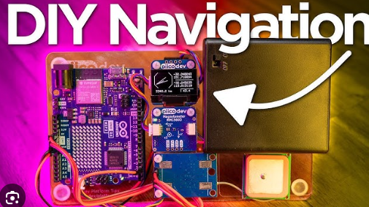
Navigation
GPS gives Robo-Cub its location outside so it knows where it is on campus
SLAM keeps track of position and builds a map indoors where GPS doesn’t work
We use both GPS and SLAM so Robo-Cub can navigate outdoors and indoors reliably without getting lost.
A Raspberry Pi or arduino runs the control code
https://www.youtube.com/watch?v=F9lim5l9R7c

Slide 5
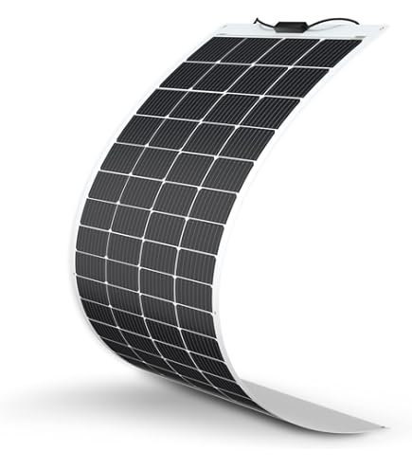
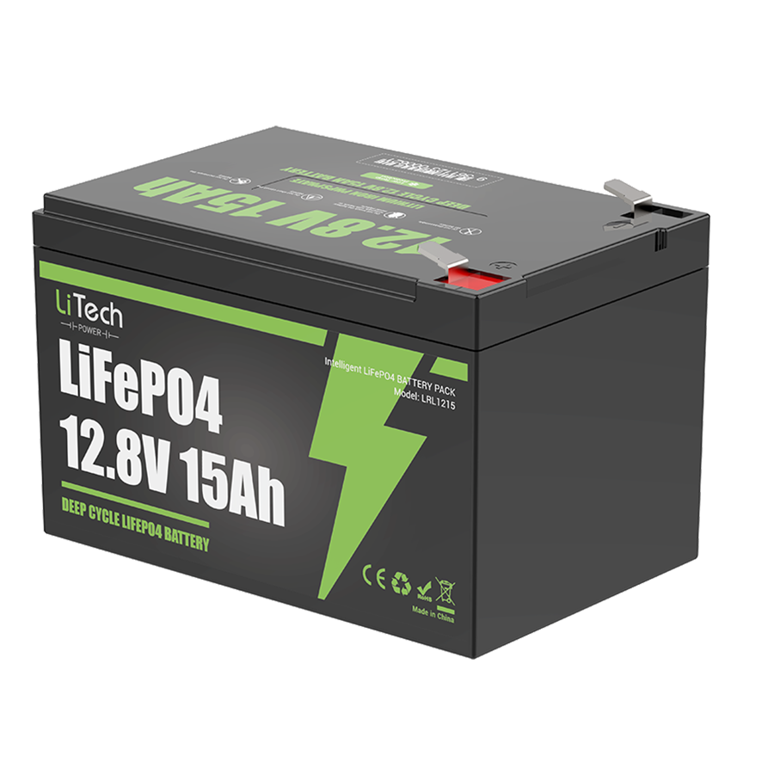
Solar power/ Battery
Solar Power / Battery
  Mount the main solar panel on the hat, tilted slightly upward for better sunlight capture.
  Add a smaller rear panel on the top rails to collect light when the hat casts a shadow.
  Example: Dakota Lithium 20 W Flexible 12 V Solar Panel: Lightweight, flexible, and ideal for curved surfaces.
Why Lithium Batteries?
  High Energy Density: Compact and lightweight for mobile use.
  Long Lifespan: Withstands many charge cycles with minimal degradation.
  Low Self-Discharge: Holds charge well between uses — great for intermittent operation.
  Example: 12.8 V 15 Ah LiFePO₄ which would handle like 3 hours of charge for what we are asking
    4.6 V CC/CV charger, 3–10 A which would take about 3-4 hours to go from low to full
    A small base the robot noses into so it can stay still to plug feed a smart charger

Slide 6
Ai research
Arduino Uno can not handle the navigation ai with also sensor
We could do this though:
Brain: Raspberry Pi parses intent and sends simple commands to Arduino
Arduino: Handles motors, sensors, safety; speaks status on events
  We can code words like
  Wake Word + Commands: “Scotty… take me to Humanities”
We can also do :
Speech-to-Text: Vosk (offline)
Text-to-Speech: Piper (natural voice)
What is vosk and piper:
  Vosk: Basically the ear and brain : Very accurate for small, focused word sets.
  Piper: Basically scotty's voice: uses neural voices, so it sounds natural, not robotic.

Slide 7
Company outreach
Company’s I’ll probably reach out to before next week so we can see if we can get discounts or anything off our equipment in future:
Dakota Lithium → battery support
Renogy → solar panel support
SparkFun → sensors / microcontrollers
Picovoice.ai → voice AI license
Adafruit Industries → electronics discounts

Slide 8
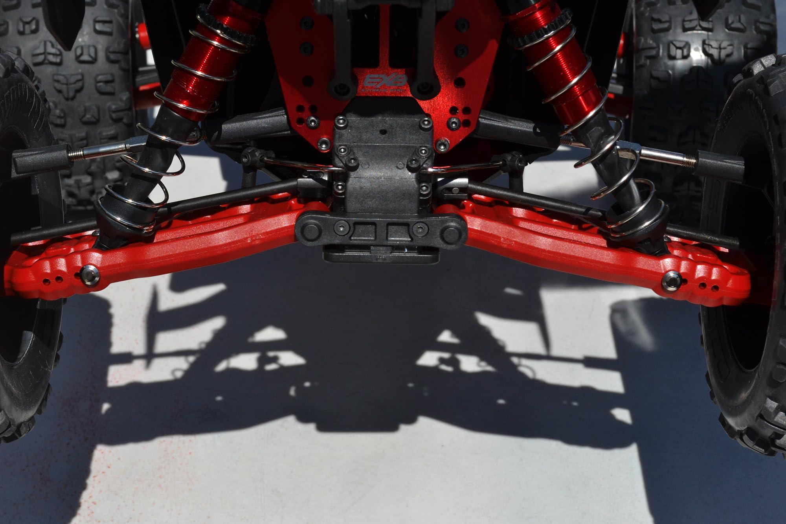
Suspension System / Mechanical Upgrade
The current RoboCUB can only operate reliably on very flat floors due to its rigid frame, which leads to poor traction and balance on rough or sloped surfaces.
This year’s update introduces a compact suspension system to:
  Maintain even ground contact on uneven surfaces
  Improve stability and traction during skid-steer turning
  Reduce stress on the chassis and electronics
Suspension design is inspired by RC off-road vehicles (e.g., Arrma Outcast 8S).
Uses coil-over shock absorbers to allow each wheel limited vertical travel.

Slide 9
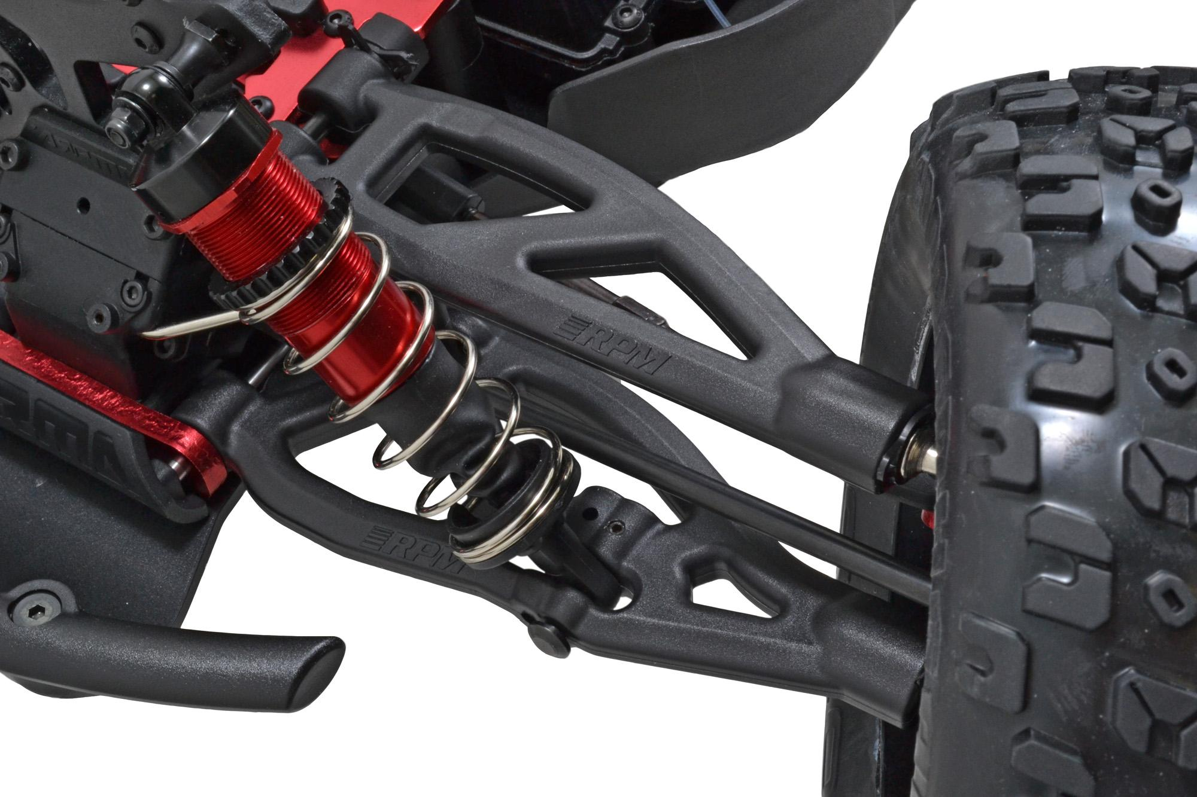
Suspension Goals and Integration Plan
Goals
  Improve maneuverability during differential (skid-steer) motion
  Keep robot level while crossing joints or ramps
  Protect internal components from vibration and impact
Components under consideration:
  Arrma Outcast or other similar RC Vehicle shocks (lightweight aluminum, oil-filled)
  Custom 3D-printed mounts and arms
Testing Plan:
  Compare current rigid frame vs. suspended setup using load and traction tests
  Determine appropriate spring stiffness for balance between stability and compliance

